Slide 1
BGP 📣
Discussion 5
CS 168, Summer 2025 @ UC Berkeley
Slides credit: Sylvia Ratnasamy, Rob Shakir, Peyrin Kao, Iuniana Oprescu
Notes:
Slides template credit: Josh Hug, Lisa Yan

Slide 2
Logistics
Project 2: Routing
  Deadline: Thursday, July 10th
Midterm on July 22nd, 7-9pm (put it in your calendar)!
  You can bring two 8.5” x 11” cheat sheets, each two-sided (4 sides total)
  Scope TBD

Slide 3
Routing
Interdomain Routing
Export & Selection
Types of ASes

Slide 4
Interdomain Routing
Interdomain routing is between autonomous systems (AS)
  Similar goals as intradomain routing with scalability + policy compliance
  Autonomous systems want privacy and autonomy
Border gateway protocol (BGP) is current design
  Extends on top of DV (with some crucial differences)

Slide 5
Export & Selection
If you are an AS:
  Route Selection
    Where you send your packets
    Determine how to choose a valid route to a given IP prefix, when multiple paths through ASes
  Route Export
    Which ASes will receive your route
    Other ASes will select your route and send traffic to you

Slide 6


Export & Selection
UCB and Facebook export their route to Stanford
They agree to carry AT&T’s traffic to Stanford
Stanford this way!
UC Berkeley
Google
AT&T
Stanford this way!
Facebook
Comcast

Slide 7
Export & Selection
AT&T selects route through UC Berkeley
AT&T might now send traffic to Stanford via UCB
UC Berkeley
Stanford this way!
Google
AT&T
Facebook
Comcast

Slide 8
Export & Selection
AT&T exports route to Google only
Agrees to carry Google’s traffic to Stanford, but not Comcast’s
UC Berkeley
Stanford this way!
Google
AT&T
Facebook
Comcast

Slide 9
Types of ASes (domains)
Stub: only sends/receives traffic for its users
  companies, universities, etc.
Transit: carries traffic for other ASes
  Global ISPs (Tier 1): fully connected mesh
  Regional ISPs (Tier 2)
  Local ISPs (Tier 3)
Lower tiers buy service from higher tiers
What’s the relationship between AS and ISP?
  All ISPs are ASes, but not all ASes are ISPs
  E.g. UC Berkeley is not an ISP but it is an AS
Tier 1 ASes
A
B
C
Notes:
AS vs ISP: AS is a network that participates in the Internet; ISP provides internet access to others

Slide 10
Business Relationship among ASes
Two ASes will connect only if they have business relationship:
  Customer-Provider
    Provider B carries customer A’s traffic for a fee
  Peers
    Peers A, B carry each other’s traffic for free
What roles can a global ISP (Tier 1) have?
  Provider to Tier 2 or Tier 3
  Peer to other global ISP (tier 1)
  Not a customer!

Slide 11
Business Relationship Restrictions
The graph of peering relations can be cyclic
  The peer of my peer can also be my peer
  For example, global ISPs all peer with each other
The graph of customer-provider relations must be acyclic

Slide 12
BGP: The Big Picture
How does this fit with what we’ve learned so far?

Slide 13
Three parts of Gateway Protocols
eBGP
  Between border routers in different ASes
  Learn about external routes
iBGP
  Between border routers and other routers within a single AS
  Learn which border router to use to reach external destinations
IGP
  The protocol used for intradomain routing (e.g. OSPF).
    Shortest path to subnet in the same AS
    Shortest path to border router for given external network
  Just a different name for L3 routing as we’ve talked about earlier
Notes:
eBGP — Learn routes to external destinations
iBGP — Distribute externally learned routes internally
IGP (“Interior Gateway Protocol” = Intradomain routing protocol) — Provide internal reachability, Travel shortest path to egress
Every router in AS has two routing tables
From IGP: next hop router to all internal destinations
From iBGP: egress router to all external destinations
For internal addresses (i.e. within AS), just use IGP
For external locations: use iBGP to find egress
main summary:
Scope: IGP (internal), EBGP (between AS), IBGP (within AS)
Purpose: IGP (internal routing), BGP (internet routing)

Slide 14
BGP Route Attributes
Attributes: Parameters used in route selection
  Local attributes
    ASes keep them private
    Not included in eBGP route announcements
    E.g. LOCAL_PREF
  Nonlocal attributes:
    propagated with eBGP route announcements
    E.g. AS_PATH
Notes:
LOCAL PREFERENCE : AS can assign a higher value to more preferred routes (e.g. from customers), and a lower value to less preferred routes (e.g. from providers)
ASPATH : attribute contains a list of ASes along the route being advertised (in reverse order)

Slide 15
Route Selection in Priority Order
Priority | Rule | Remarks
1 | LOCAL PREF | Pick highest LOCAL PREF
2 | ASPATH | Pick shortest ASPATH length
3 | IGP cost | Lowest IGP cost to next hop (egress router)
4 | MED | Lowest MED preferred
5 | Router ID | Smallest next-hop router’s IP address as tie-breaker Classless addressing is used
Notes:
Multi-Exit Discriminator (MED) preferred output packet
→ ASes are interconnected via 2 or more links to specify how close a prefix is to the link it is announced on
iBGP path is to get the packet out quickly
Deeper slides are Hidden out
TABLE from LECTURE Priority Rule Remarks
1 LOCAL PREF Pick highest LOCAL PREF
2 ASPATH Pick shortest ASPATH length
3 IGP path Lowest IGP cost to next hop
(egress router)
4 MED MED preferred
5 Router ID Smallest next-hop router’s IP
address as tie-breaker
The BGP best path selection process is enforced when multiple routes exist for the same destination.
It is applied on every BGP-speaking router when deciding which route to install in the routing table and advertise to peers.
It runs every time BGP receives a route update or when network conditions change, such as:
A new route is received.
A route is withdrawn.
Attributes of a route change (e.g., LOCAL PREF or MED is updated).
This process applies to both iBGP and eBGP, but:
LOCAL PREF is only used in iBGP.
MED is typically used in eBGP.
ASPATH is more relevant to eBGP.
IGP cost is more relevant to iBGP.

Slide 16
Priority Oscillation

Slide 17
Policy Oscillation
Each node prefers route through neighbor over direct route.
1
Suppose initially each node only knows the shortest path to 0 (green arrow).
1 prefers reaching 0 through 2 or 3
2 prefers reaching 0 through 1 or 3
3 prefers reaching 0 through 1 or 2
0
1 knows 1→0
2 knows 2→0
3 knows 3→0
2
3

Slide 18
Policy Oscillation 1
Each node prefers route through neighbor over direct route.
1
Suppose initially each node only knows the shortest path to 0 (green arrow).
1 prefers reaching 0 through 2 or 3
2 prefers reaching 0 through 1 or 3
3 prefers reaching 0 through 1 or 2
0
1 knows 1→0
2 knows 2→0
3 knows 3→0
2
3
1 advertises 1→0 to 2

Slide 19
Policy Oscillation 2
Each node prefers route through neighbor over direct route.
1
Suppose initially each node only knows the shortest path to 0 (green arrow).
1 prefers reaching 0 through 2 or 3
2 prefers reaching 0 through 1 or 3
3 prefers reaching 0 through 1 or 2
0
1 knows 1→0
2 knows 2→0
3 knows 3→0
2
3
3 advertises 3→0 to 1

Slide 20
Policy Oscillation 3
Each node prefers route through neighbor over direct route.
1
Suppose initially each node only knows the shortest path to 0 (green arrow).
1 prefers reaching 0 through 2 or 3
2 prefers reaching 0 through 1 or 3
3 prefers reaching 0 through 1 or 2
0
1 knows 1→0
2 knows 2→0
3 knows 3→0
2
3
1 withdraws its path of 1→0 from 2 (because 1 now takes 1->3->0)

Slide 21
Policy Oscillation 4
Each node prefers route through neighbor over direct route.
1
Suppose initially each node only knows the shortest path to 0 (green arrow).
1 prefers reaching 0 through 2 or 3
2 prefers reaching 0 through 1 or 3
3 prefers reaching 0 through 1 or 2
0
1 knows 1→0
2 knows 2→0
3 knows 3→0
2
3
2 now advertises 2→0 to 3
(3 would take it as it favors its neighbor)

Slide 22
Policy Oscillation 5
Each node prefers route through neighbor over direct route.
1
Suppose initially each node only knows the shortest path to 0 (green arrow).
1 prefers reaching 0 through 2 or 3
2 prefers reaching 0 through 1 or 3
3 prefers reaching 0 through 1 or 2
0
1 knows 1→0
2 knows 2→0
3 knows 3→0
2
3
3 now withdraws 3→0 from 1

Slide 23
Policy Oscillation 6
Each node prefers route through neighbor over direct route.
1
Suppose initially each node only knows the shortest path to 0 (green arrow).
1 prefers reaching 0 through 2 or 3
2 prefers reaching 0 through 1 or 3
3 prefers reaching 0 through 1 or 2
0
1 knows 1→0
2 knows 2→0
3 knows 3→0
2
3
1 again advertises its path 1→0

Slide 24
Policy Oscillation 7
Each node prefers route through neighbor over direct route.
1
Suppose initially each node only knows the shortest path to 0 (green arrow).
1 prefers reaching 0 through 2 or 3
2 prefers reaching 0 through 1 or 3
3 prefers reaching 0 through 1 or 2
0
1 knows 1→0
2 knows 2→0
3 knows 3→0
Back to where we started! :(
2
3
2 withdraws its path 2→0 from 3

Slide 25
Why doesn’t this happen in reality?
Gao-Rexford!

Slide 26
Gao-Rexford Policy
Destination prefix advertised by… | Export route to…
Customer | Everyone (providers, peers, other customers)
Peer | Customers
Provider | Customers
Notes:
Used to avoid policy oscillation
Customer below you, peer next to you, and provider above you (in terms of the diagram on next slide)

Slide 27
Routing Follows the Money
Peers do not provide transit to other peers!
A
B
C
D
E
F
G
Traffic allowed
Traffic not allowed
Notes:
Multi-Exit Discriminator

Slide 28
Gao-Rexford Policy Continued
customers
peers
providers
  Green arrow is where you learn the route
  Purple arrows are where you export the route
  With Gao-Rexford
    The AS policy graph is a DAG
    Routes are “valley free”/”single-peaked”
Notes:
Since AS policy graph is a DAG, no cycles, hence no oscillation

Slide 29
Gao-Rexford avoids Policy Oscillation
Example shown before did not use Gao-Rexford (why?)
  1, 2, and 3 are peers
  0 is the provider to 1, 2, and 3
  Peers don’t advertise route learned from providers to each other
    i.e. 1 would never advertise 1->0 (learned from 1’s provider 0) to 2 (1’s peer)
1
Destination prefix advertised by… | Export route to…
Peer | Customers
0
2
3
Notes:
Since AS policy graph is a DAG, no cycles, hence no oscillation

Slide 30
Worksheet
True/False
Interdomain vs Intradomain
BGP

Slide 31
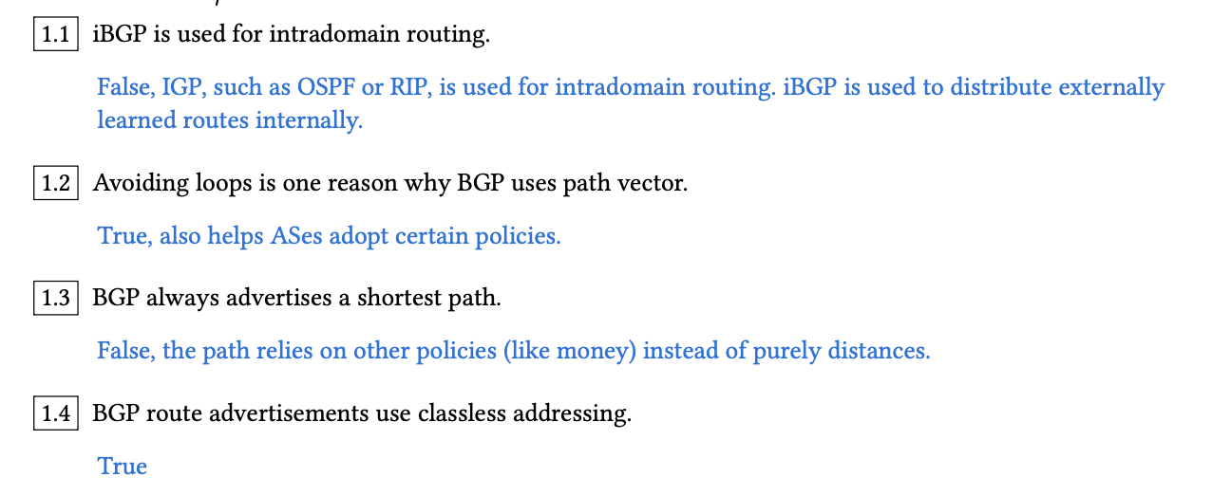
Question 1: True/False

Slide 32
Worksheet
True/False
Interdomain vs Intradomain
BGP

Slide 33
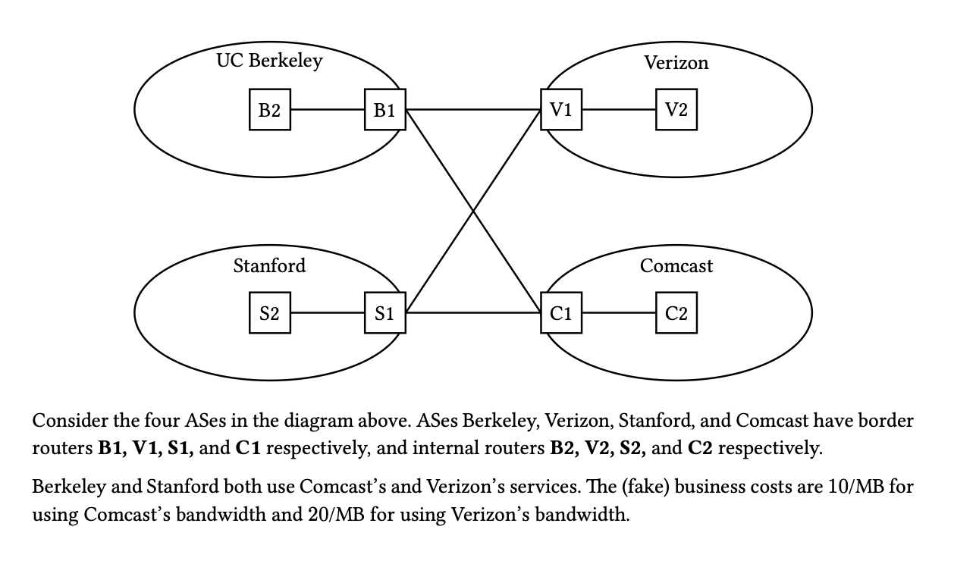
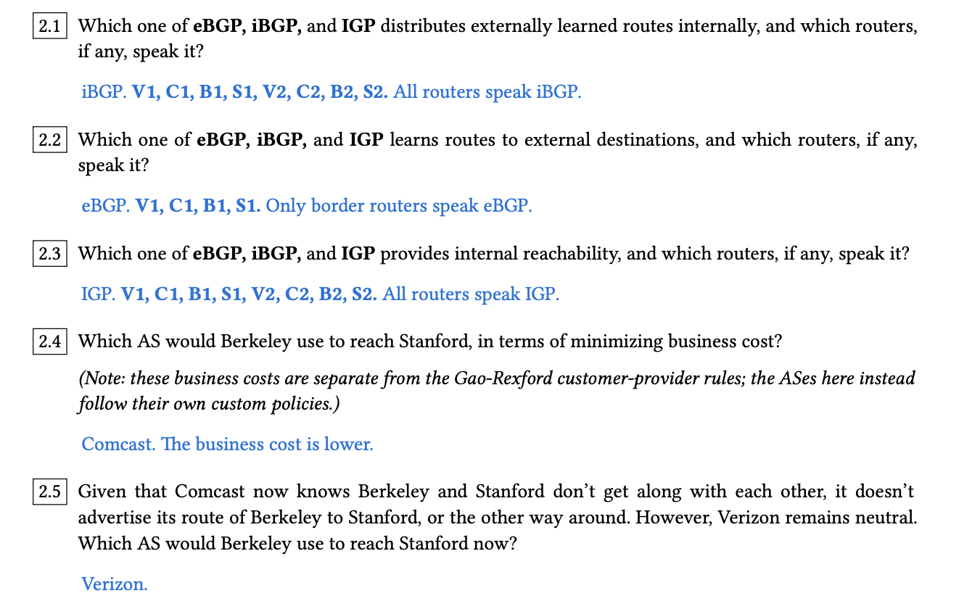
Question 2: Interdomain vs Intradomain

Slide 34
Worksheet
True/False
Interdomain vs Intradomain
BGP

Slide 35
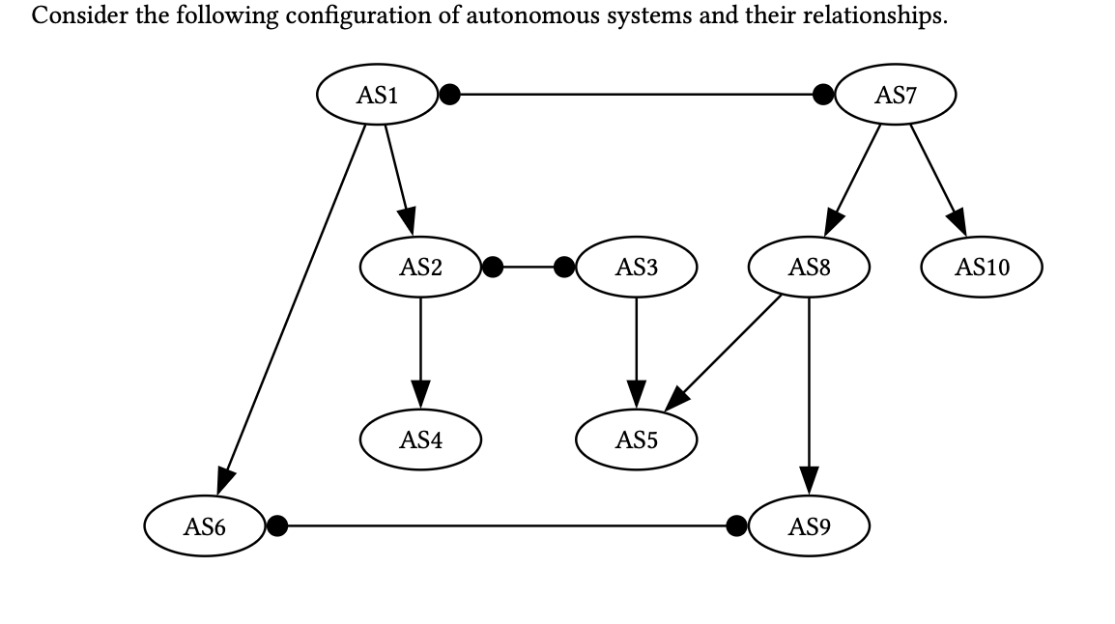
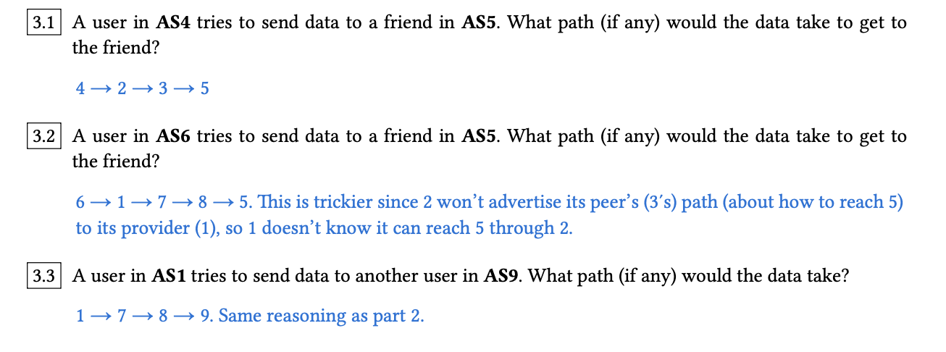
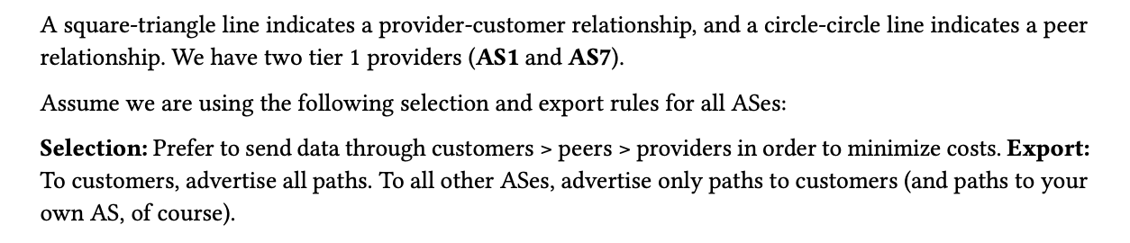
Question 3: BGP

Slide 36
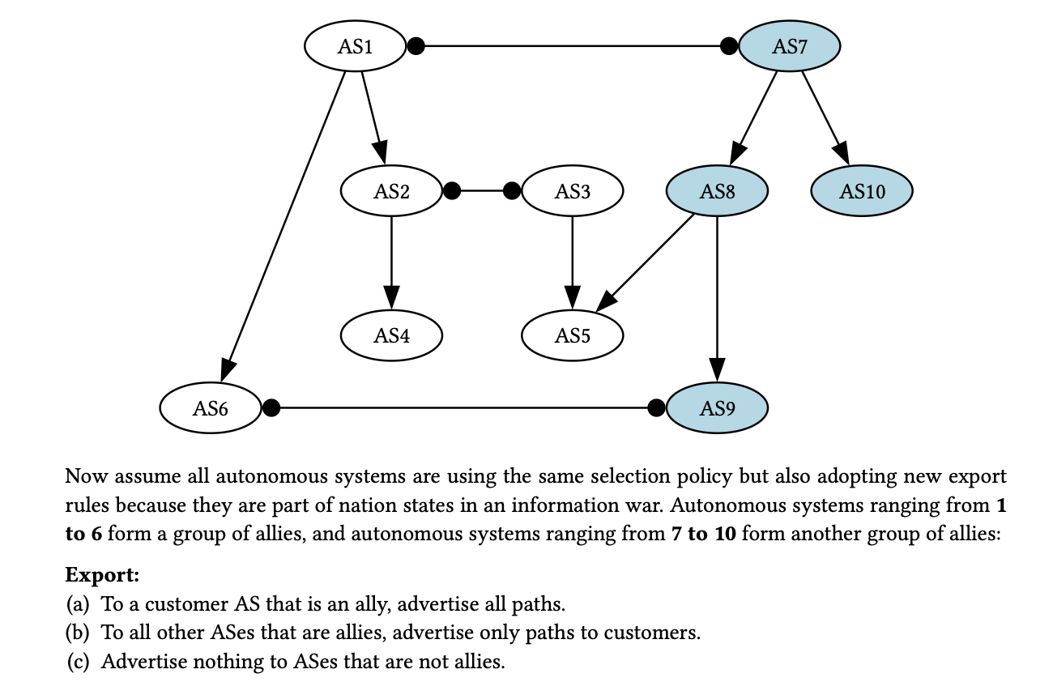
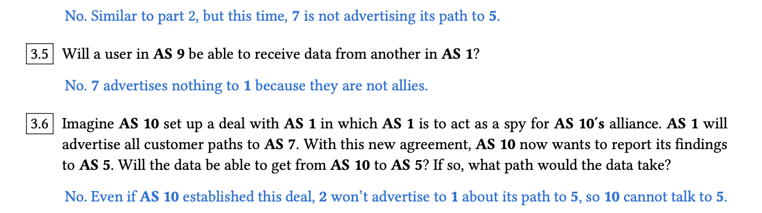
Question 3: BGP

Slide 37

Questions?
Feedback Form: https://tinyurl.com/cs168-su25-disc-feedback

